Slide 1

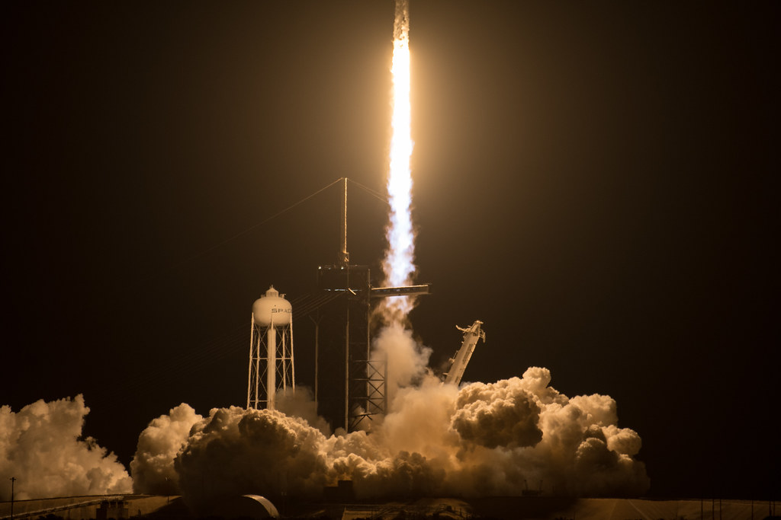

Winning the Space Race with Data Science
James Porter
15 Aug 2023

Slide 2

Outline
Executive Summary
Introduction
Methodology
Results
Conclusion
Appendix

Slide 3
Executive Summary
Summary of methodologies
Data Collection
Data Wrangling
Exploratory Data Analysis with SQL
Exploratory Data Analysis Visualization
Visual Analytics with Folium
Interactive Dashboard with Plotly
Predictive Analysis
Summary of all results
Exploratory Data Analysis Results
Interactive Analytics Demo
Predictive Analysis Results

Slide 4
Introduction
Project Background and Context:
In this capstone, we will predict if the Falcon 9 first stage will land successfully. SpaceX advertises Falcon 9 rocket launches on its website, with a cost of 62 million dollars; other providers cost upward of 165 million dollars each, much of the savings is because SpaceX can reuse the first stage. Therefore if we can determine if the first stage will land, we can determine the cost of a launch. This information can be used if an alternate company wants to bid against SpaceX for a rocket launch.
Questions wanting to answer:
Price per launch
Probability of a successful landing

Slide 5

Section 1

Slide 6
Methodology
Executive Summary
Data collection methodology:
SpaceX REST API
Web Scraping of Wikipedia
Perform data wrangling
Filtering Data
Dealing with Missing Values
One Hot Encoding to Prepare Data
Perform exploratory data analysis (EDA) using visualization and SQL

Slide 7
Methodology
Executive Summary
Perform interactive visual analytics using Folium and Plotly Dash
Perform predictive analysis using classification models
Collected data was normalized, divided into training and test data sets, and applied to four different classification models.

Slide 8
Data Collection
The process of gathering data encompassed a blend of API requests from SpaceX's REST API and the extraction of information through web scraping from a table within SpaceX's Wikipedia page. The utilization of both these methods was essential to acquire a comprehensive dataset for a more intricate analysis.
The data columns were populated using SpaceX's REST API, including FlightNumber, Date, BoosterVersion, PayloadMass, Orbit, LaunchSite, Outcome, Flights, GridFins, Reused, Legs, LandingPad, Block, ReusedCount, Serial, Longitude, and Latitude.
Furthermore, the data columns sourced from Wikipedia web scraping encompassed Flight Number, Launch Site, Payload, PayloadMass, Orbit, Customer, Launch Outcome, Booster Version, Booster Landing, Date, and Time.

Slide 9
Data Collection – SpaceX API
Request the SpaceX API and collect the launch data
SpaceX provides an API to allow access to it's data.
This data was collected and processed to use as part of our dataset.
Filter Data to only show Falcon 9 rocket data
Deal with missing values
GITHUB – Data Collection API

Slide 10
Data Collection - Scraping
Locate the Falcon 9 launch data Wiki Page
Wikipedia also contains a wealth of information about SpaceX launches.
Extract names from the HTML table header
Create a Data Frame from the collected HTML tables
GITHUB – Data Collection Web Scraping

Slide 11
Data Wrangling
Here the data was explored to identify the different types of data that we could use to formulate identifying factors that contributed to either successful or failed landing attempts.
Calculate number of launches on each site
Calculate the number and occurrence of each orbit
Calculate mission outcome per orbit type
Create landing outcome labels
GITHUB – Data Wrangling

Slide 12
EDA with Data Visualization
The following charts were plotted. These were chosen to see how different variables affected the landing outcome:
FlightNumber vs. PayloadMass
FlightNumber vs LaunchSite
Payload Vs. LaunchSite
sucess rate of each orbit
FlightNumber and Orbit type.
Payload vs. Orbit
GITHUB – EDA with Data Visualization

Slide 13
EDA with SQL
SQL queries performed:
select distinct Launch_Site from spacextbl
select * from spacextbl where Launch_Site LIKE 'CCA%' limit 5;
select sum(PAYLOAD_MASS__KG_) from spacextbl where Customer = 'NASA (CRS)'
select avg(PAYLOAD_MASS__KG_) from spacextbl where Booster_Version LIKE 'F9 v1.1';
select min(Date) as min_date from spacextbl where "Landing_Outcome" = 'Success (ground pad)';
select Booster_Version from spacextbl where (PAYLOAD_MASS__KG_> 4000 and PAYLOAD_MASS__KG_ < 6000) and (Landing_Outcome = 'Success (drone ship)');
select Mission_Outcome, count(Mission_Outcome) as counts from spacextbl group by Mission_Outcome;
select Booster_Version, PAYLOAD_MASS__KG_ from spacextbl where PAYLOAD_MASS__KG_ = (select max(PAYLOAD_MASS__KG_) from spacextbl);
select Landing_Outcome, Booster_Version, Launch_Site from spacextbl where Landing_Outcome = 'Failure (drone ship)' and year(Date) = '2015'
select Landing_Outcome, count(*) as LandingCounts from spacextbl where Date between '2010-06-04' and '2017-03-20' group by Landing_Outcome order by count(*) desc;
GITHUB – EDA with Data Visualization

Slide 14
Interactive Map with Folium
Markers Indicating Launch Sites
• Added blue circle at NASA Johnson Space Center's coordinate with a popup label
showing its name using its latitude and longitude coordinates
• Added red circles at all launch sites coordinates with a popup label
showing its name using its name using its latitude and longitude coordinates
Colored Markers of Launch Outcomes
• Added colored markers Of Successful (Green) and Unsuccessful (red) Launches at each launch site to
show which launch sites have high success rates
Distances Between a Launch Site to Proximities
• Added colored lines To show distance between launch site CCAFS SLC- 40 and its proximity to the nearest
coastline, railway, highway, and city

Slide 15
Dashboard with Plotly Dash
Dropdown List with Launch Sites
• Allow user to select all launch sites or a certain launch site
Pie Chart Showing Successful Launches
• Allow user to see successful and unsuccessful launches as a percent of the total
Slider of Payload Mass Range
• Allow user to select payload mass range
Scatter Chart Showing Payload Mass vs. Success Rate by Booster Version
• Allow user to see the correlation between Payload and Launch Success
GITHUB – Plotly Dashboard App

Slide 16
Predictive Analysis (Classification)
We loaded the data using numpy and pandas, transformed the data, split
our data into training and testing.
We built different machine learning models and tune different
hyperparameters using GridSearchCV.
We used accuracy as the metric for our model, improved the model using
feature engineering and algorithm tuning.
We found the best performing classification model.
GITHUB – Predictive Analysis

Slide 17
Results
Exploratory Data Analysis
Launch success has improved over time
KSC LC-39A has the highest success rate among landing sites
Orbits ES-L1, GEO, HEO and SSO have a 100% success rate
Visual Analytics
Most launch sites are near the equator, and all are close to the coast
Launch sites are far enough away from anything a failed launch can damage
(city, highway, railway), while still close enough to bring people and material
to support launch activities
Predictive Analytics
Decision Tree model is the best predictive model for the dataset

Slide 18

Section 2

Slide 19
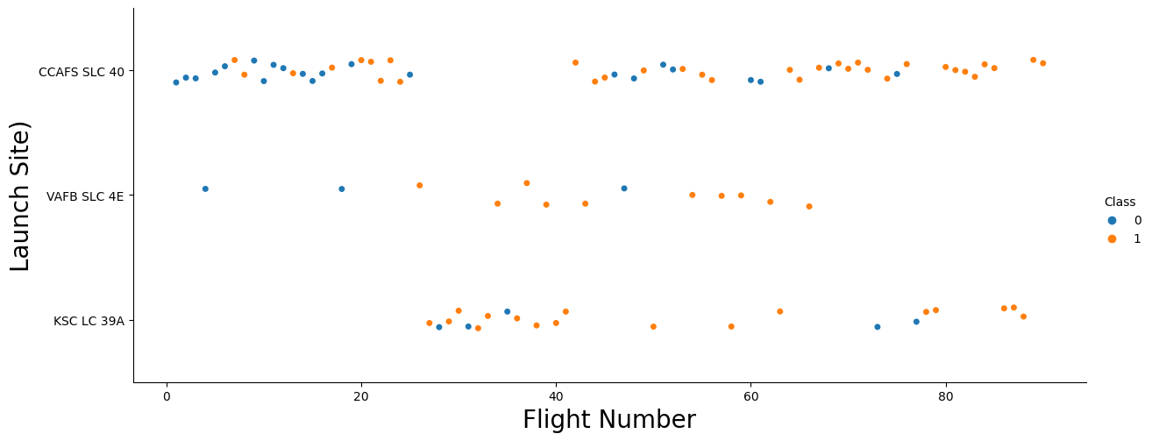
Flight Number vs. Launch Site
From the plot, we found that the more flights at a launch site, the
greater the success rate at a launch site.

Slide 20
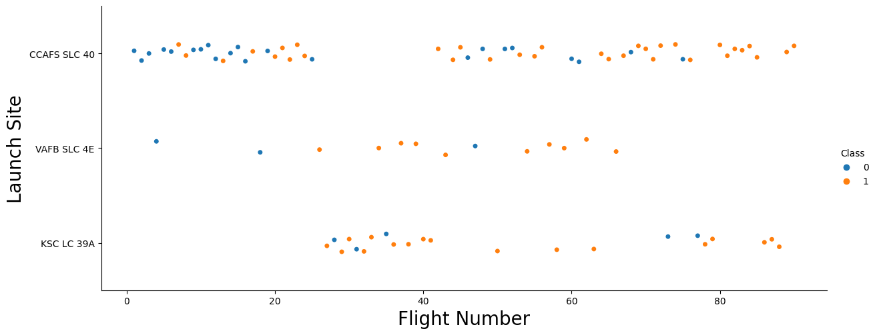
Payload vs. Launch Site
The greater the payload, the more successful the launch was at site CCAFS SLC-40

Slide 21
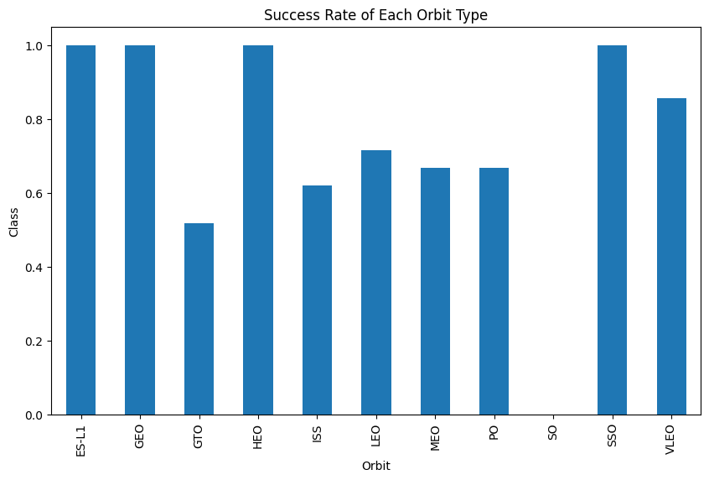
Success Rate vs. Orbit Type
ES-L1, GEO, HEO,
SSO, VLEO had the highest
success rate.

Slide 22
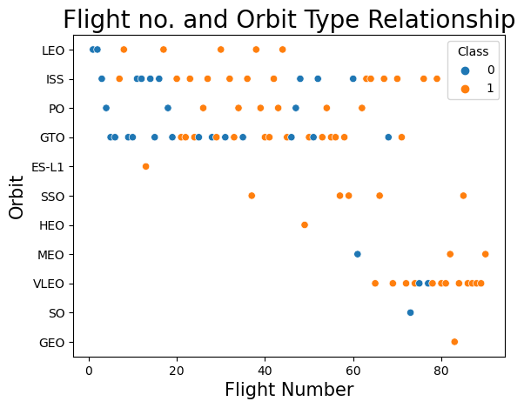
Flight Number vs. Orbit Type
We see that in the LEO orbit, success is related to the number of flights whereas in the GTO orbit, there is no relationship between flight number and the orbit.

Slide 23
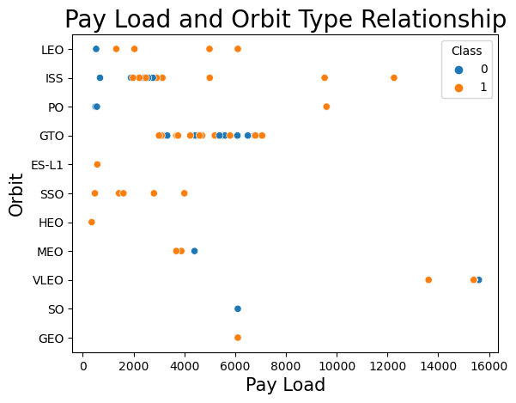
Payload vs. Orbit Type
PO, LEO and ISS orbits had more successful landings with a heavier payload.

Slide 24
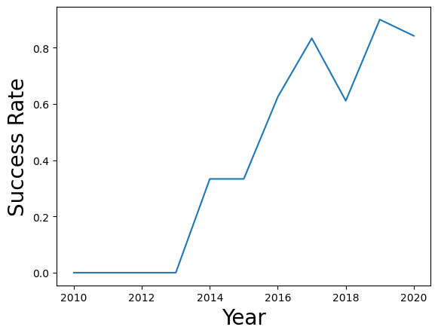
Launch Success Yearly Trend
We can see the launch success has increased over time.

Slide 25
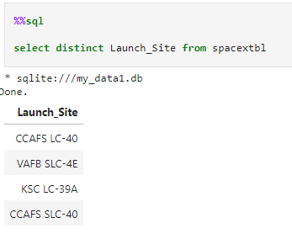
All Launch Site Names
We used the key word DISTINCT to show only
unique launch sites from the SpaceX data.

Slide 26
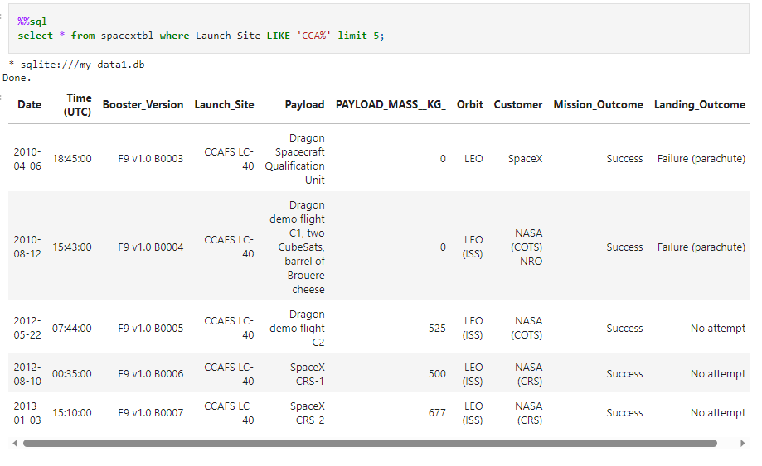
Launch Site Names Begin with 'CCA'
We used WHERE to display 5 records where launch sites begin with
`CCA`

Slide 27
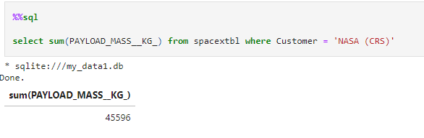
Total Payload Mass
We calculated the total payload using SUM and WHERE.

Slide 28
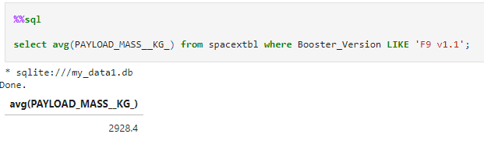
Average Payload Mass by F9 v1.1
We calculated the average
payload mass with AVG and WHERE

Slide 29
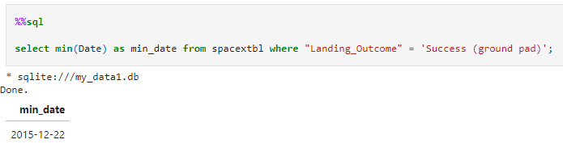
First Successful Ground Landing Date
Dates of the first successful landing date MIN and WHERE

Slide 30
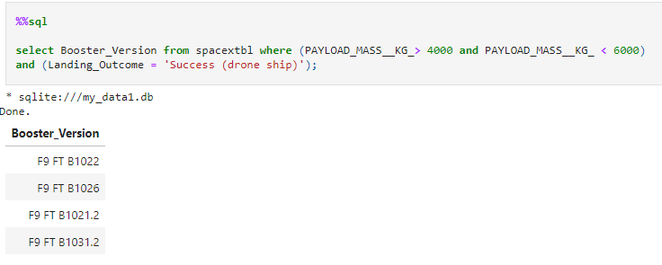
Successful Drone Ship Landing with Payload between 4000 and 6000
We found that the dates of the first successful landing outcome on
ground pad was 22nd December 2015

Slide 31
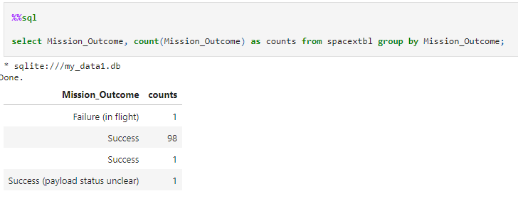
The total number of successful and failure mission outcomes were found COUNT and FROM
Total Number of Successful and Failure Mission Outcomes

Slide 32
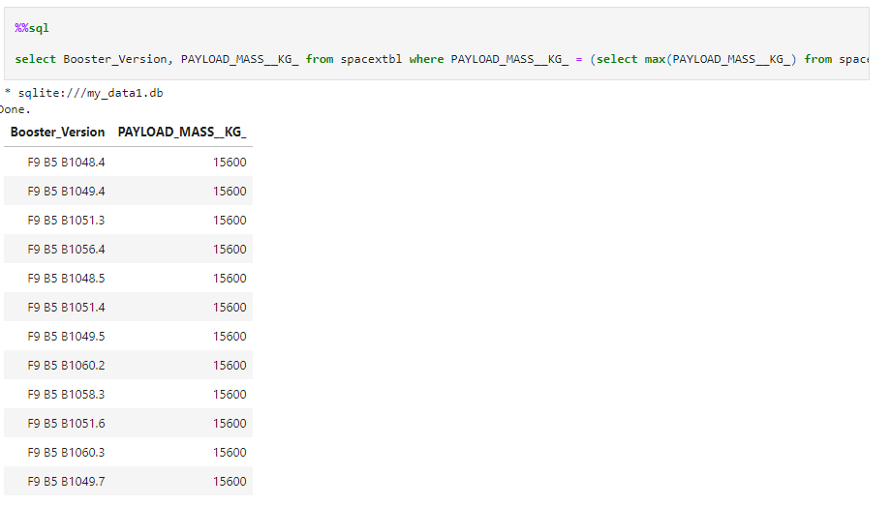
Boosters Carried Maximum Payload
The names of the booster which have carried the maximum payload mass were found using MAX

Slide 33
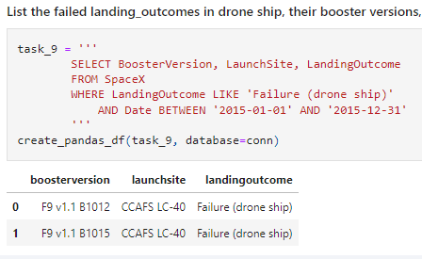
2015 Launch Records
The failed landing_outcomes in drone ship, their booster versions, and launch site names for in year 2015 using LIKE and BETWEEN.

Slide 34
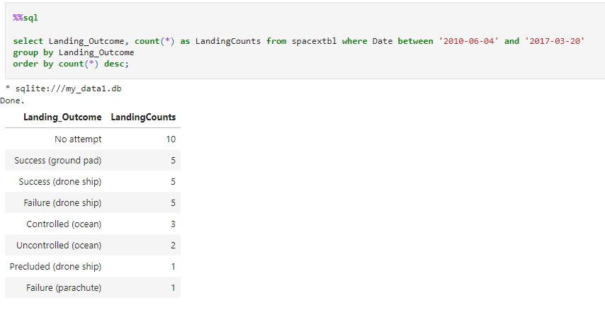
Rank Landing Outcomes Between 2010-06-04 and 2017-03-20
The count of landing outcomes (such as Failure (drone ship) or Success (ground pad)) between the date 2010-06-04 and 2017-03-20, ranked in descending order using COUNT, GROUP BY, and ORDER BY

Slide 35

Section 3

Slide 36
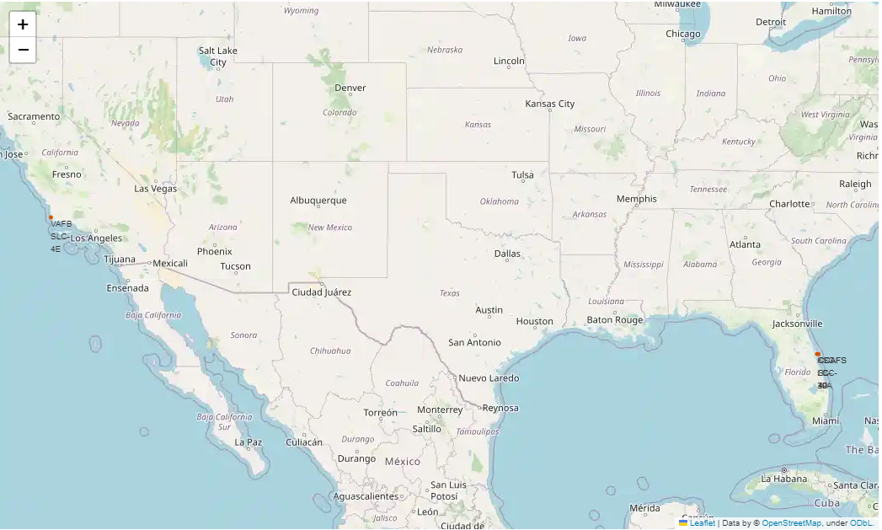
Launch Site Locations
Launch locations are on the East Coast in Florida, and the West coast in California.

Slide 37
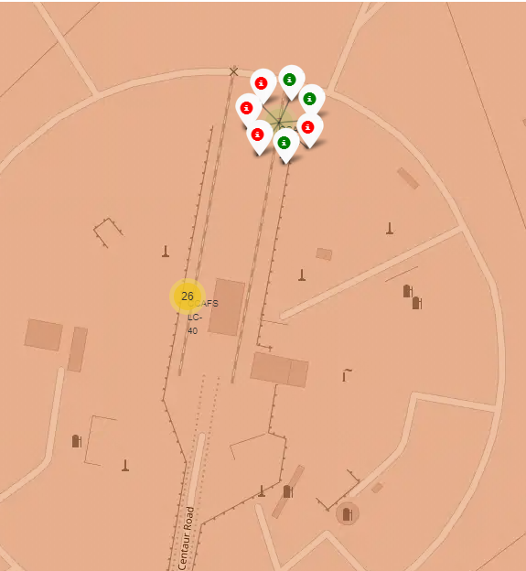
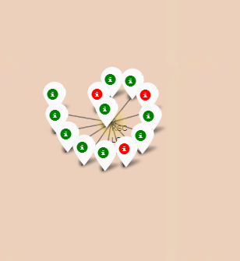
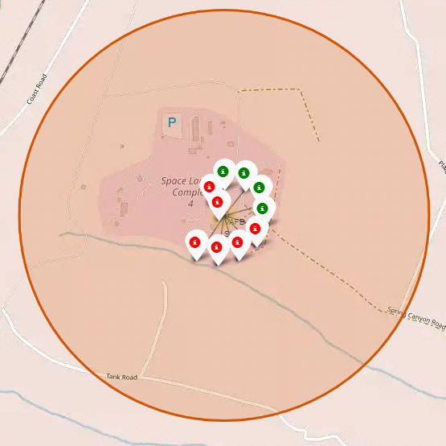
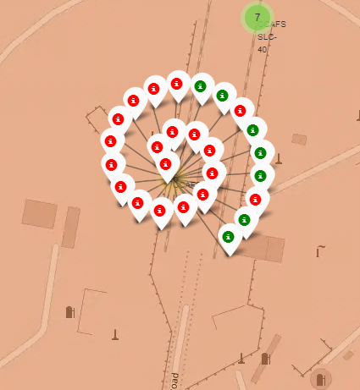
Markers Showing Launch Sites
Sites with color coded markers indicating successful/failed launches per site.

Slide 38
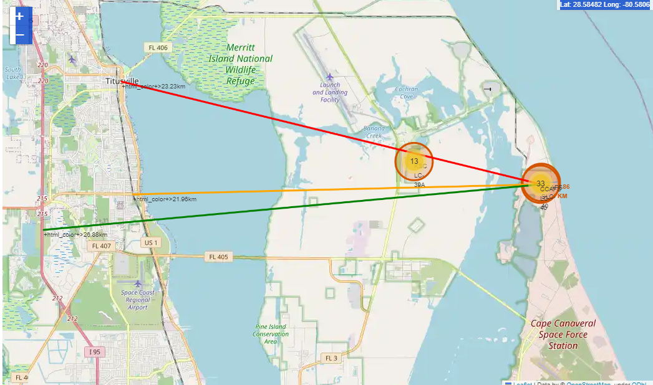
Pertinent Proximities
Map showing proximities to closest railroad, highways, and city. Indicates that care has been taken to pick launch sites with a safe distance from occupied locations

Slide 39

Section 4

Slide 40
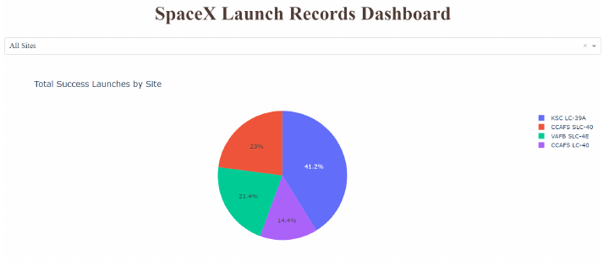
Successful Launches by Site
KSC LC-39A has the most successful launches amongst launch sites (41.2%)

Slide 41
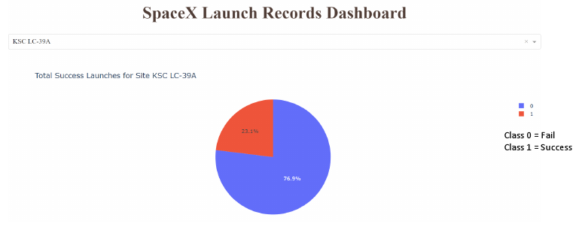
KSC LC-39A Successful Launches
KSC LC-39A had the highest success rate among all launch sites

Slide 42
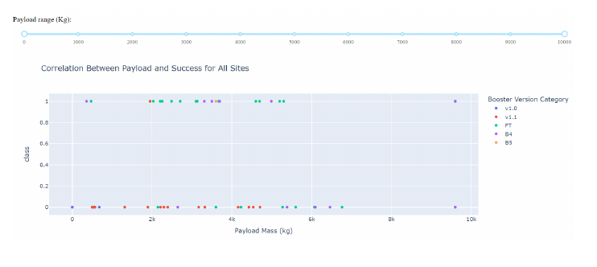
Payload Vs Success for all Sites
Scatter plot of Payload vs Launch Outcome for all sites

Slide 43

Section 5

Slide 44
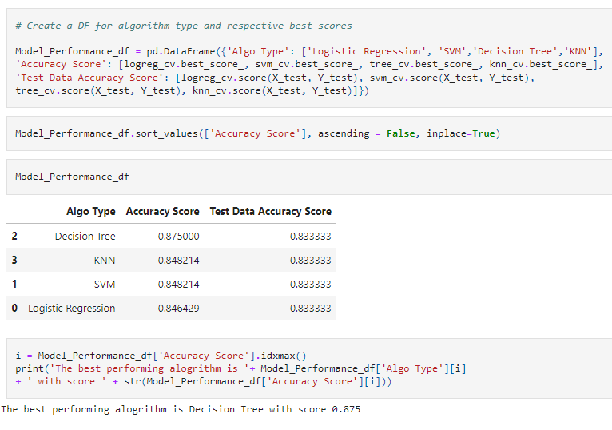
Classification Accuracy
The decision tree classifier is the model with the highest classification accuracy

Slide 45
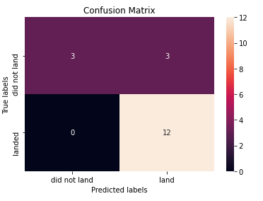
Confusion Matrix
The confusion matrixes for all the models were the same. False positives were a problem in all models.

Slide 46
Conclusions
We can conclude that:
The larger the flight amount at a launch site, the greater the success rate at a
launch site.
Launch success rate started to increase in 2013 till 2020.
Orbits ES-L1, GEO, HEO, SSO, VLEO had the most success rate.
KSC LC-39A had the most successful launches of any sites.
The Decision tree classifier is the best machine learning algorithm for this task.

Slide 47

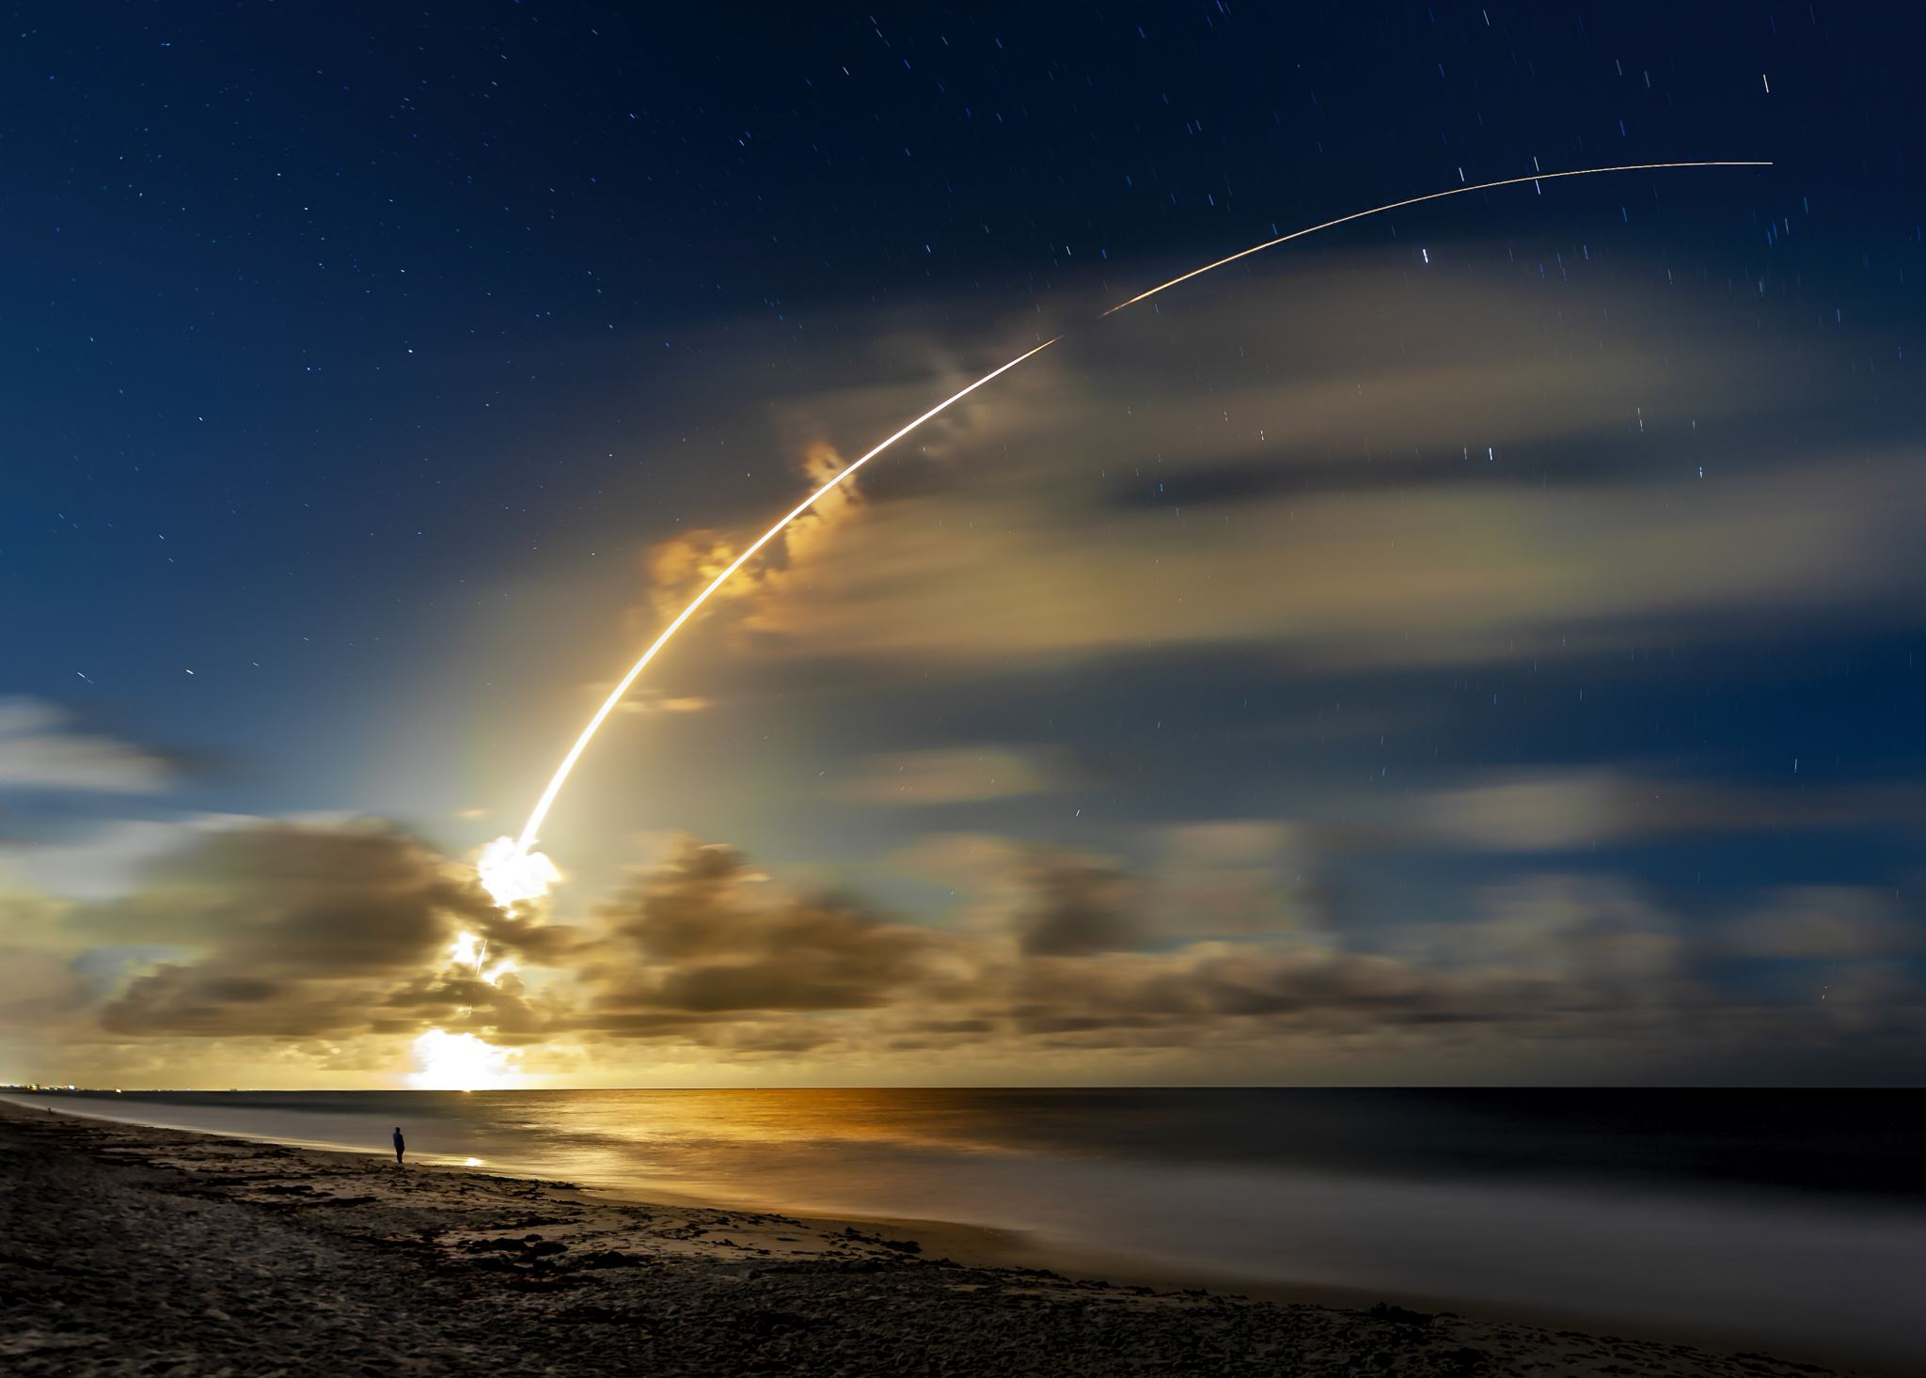
Thank You!

